Slide 1
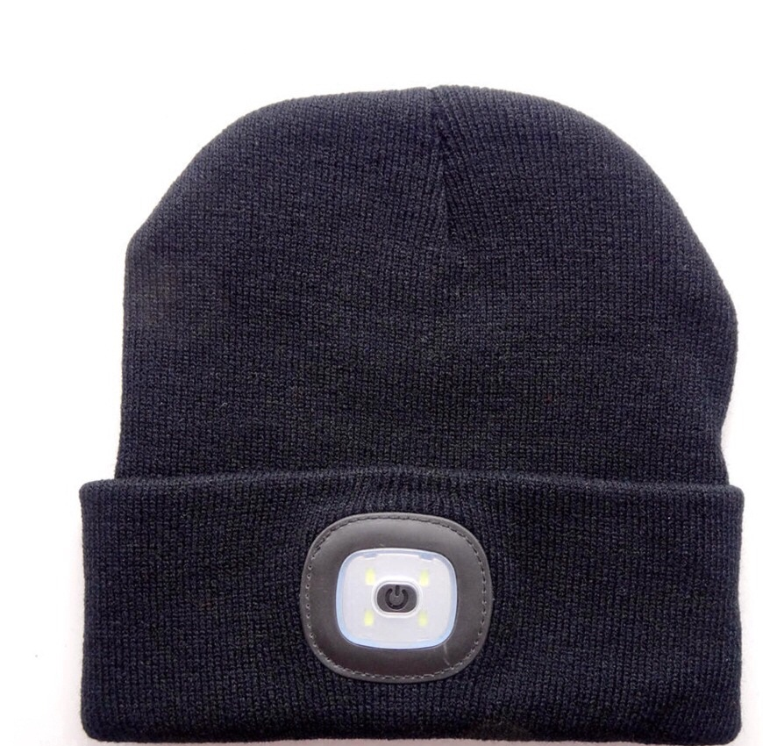
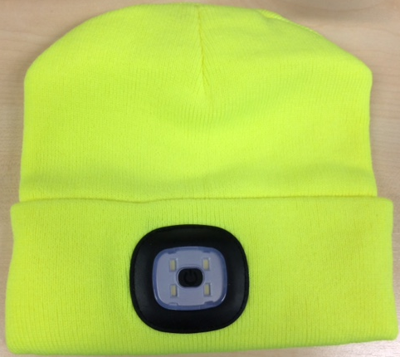
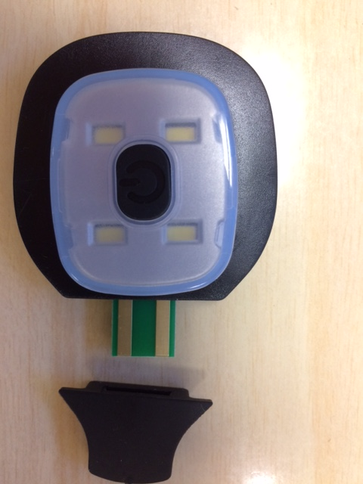
LAMP HATS
-- REMOVABLE LAMP
-- USB CHARGING
-- 3 LED MODES
-- 90 MINS CHARGE FOR 5 HOURS LIGHTING
-- 100PCS/CTN CARTON SIZE 57x54x38CM

